Slide 1
RETHINK RECYCLE
DO YOUR BIT FOR ENVIRONMENT PROTECTION

Slide 2
WHAT IS E-WASTE?
The term "e-waste" is loosely applied to consumer and business electronic equipment that is near or at the end of its useful life.
The Global E-waste Monitor defines e-waste as “all items of electrical and electronic equipment(EEE) and its parts that have been discarded by its owner as waste without the intent of reuse”

Slide 3
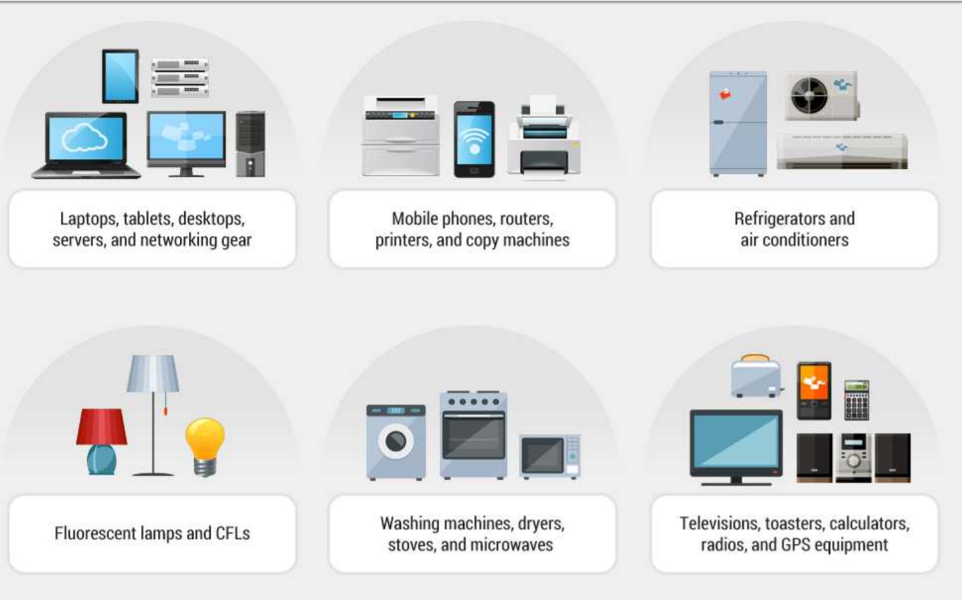
Examples of E-Waste

Slide 4
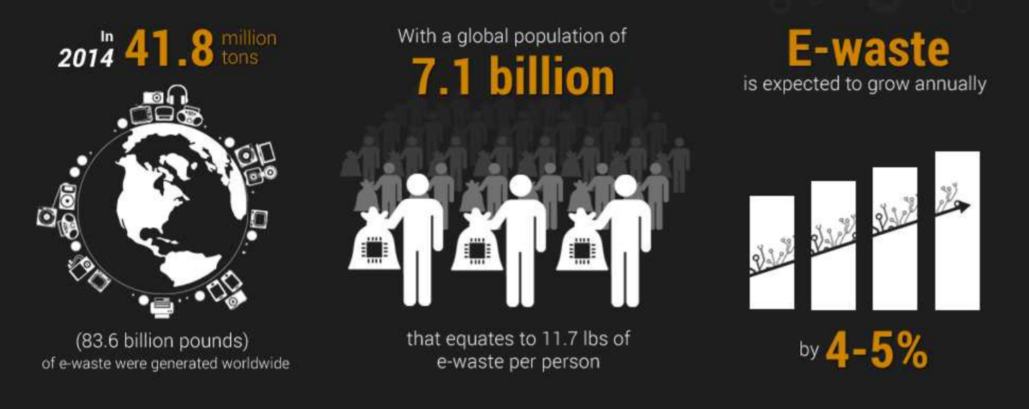
General E-waste Facts
20 to 50 million metric tons of e-waste are disposed worldwide every year.
Cell phones and other electronic items contain high amounts of precious metals like gold or silver.
For every 1 million cell phones that are recycled, 35,274 lbs of copper, 772 lbs of silver, 75 lbs of gold, and 33 lbs of palladium can be recovered.
Recycling 1 million laptops saves the energy equivalent to the electricity used by 3,657 U.S. homes in a year.

Slide 5
Turn to Rethink Recycle Application
REUSE
On the basis of the condition of the e-waste, one can buy and sell products at cheaper rates. Thus, ensuring REUSE of E-waste
RECYCLE
This application helps to recycle products in an easier way with proper disposal and extraction techniques
ENSURE PROPER DISPOSAL
Our application promises proper disposal of e-waste by calculating the pollution level at the disposal area and taking proper steps.

Slide 6
Problem statement:
Electronic waste is the major growing concern of the world. Emergence of newer technologies and exponential growth of electronic usage leads to major accumulation of e-waste. There is need of an application easily accessible to individual and organization for efficient e-waste management in the form of recycle, reuse and refurbish. Hence, we choose e-waste management as our project.
The focus of our project e-waste management is to develop such a system that can be used to properly collect e-waste, recover and recycle material by safe methods, sell and buy electronic waste, dispose of e-waste by suitable techniques, and raise awareness of the impact of e-waste.

Slide 7
APPROACH
We have integrated different enterprises that interact with each other to accomplish e-waste management
The products in our application can be reused, recycled based on their condition.
There are certain steps performed by organizations within or application to decide whether the application can be reused or recycled.
Precious metals are extracted from e-waste and are available for reuse.
Also, to ensure there is no environment pollution during disposal, our application makes use of sensors that determine the pollution rate of the region where it is supposed to be disposed. If it doesn’t meet the levels, necessary steps are taken.

Slide 8
Object Model

Slide 9
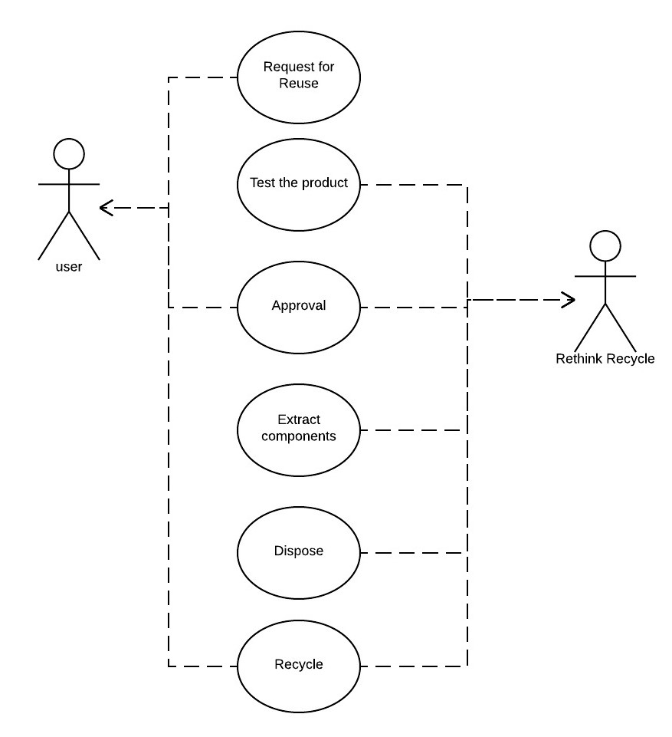
Use Case 1

Slide 10
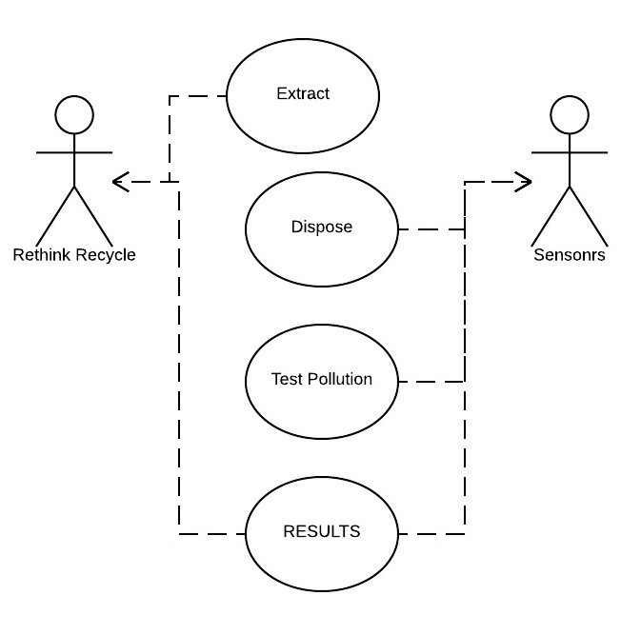
Use Case 2

Slide 11
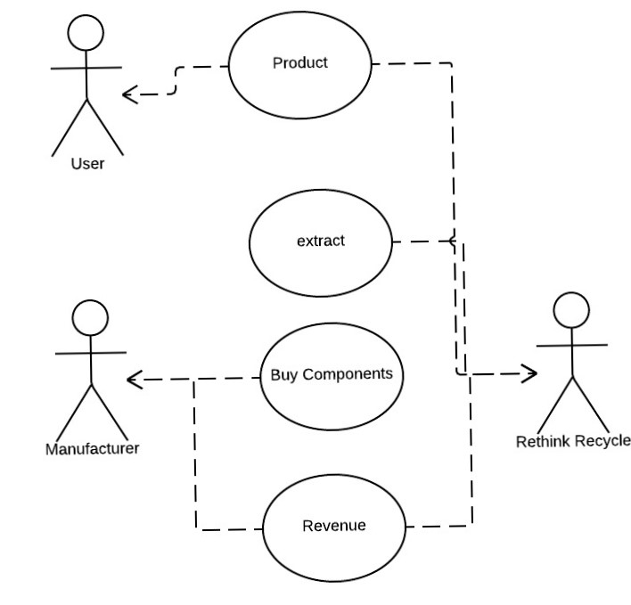
Use Case 3

Slide 12
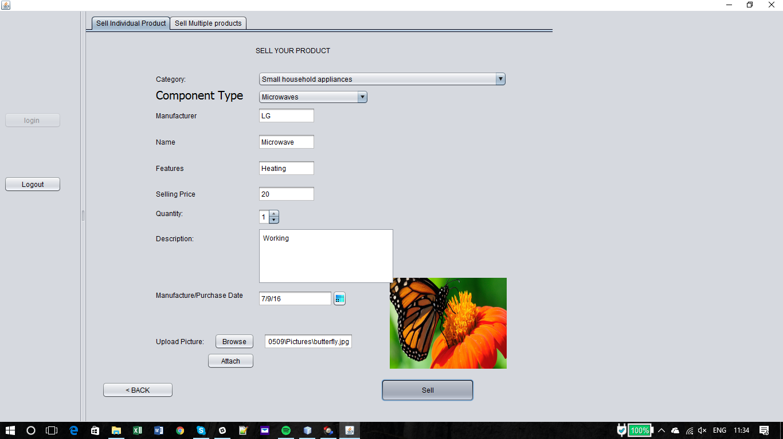
Screenshots

Slide 13
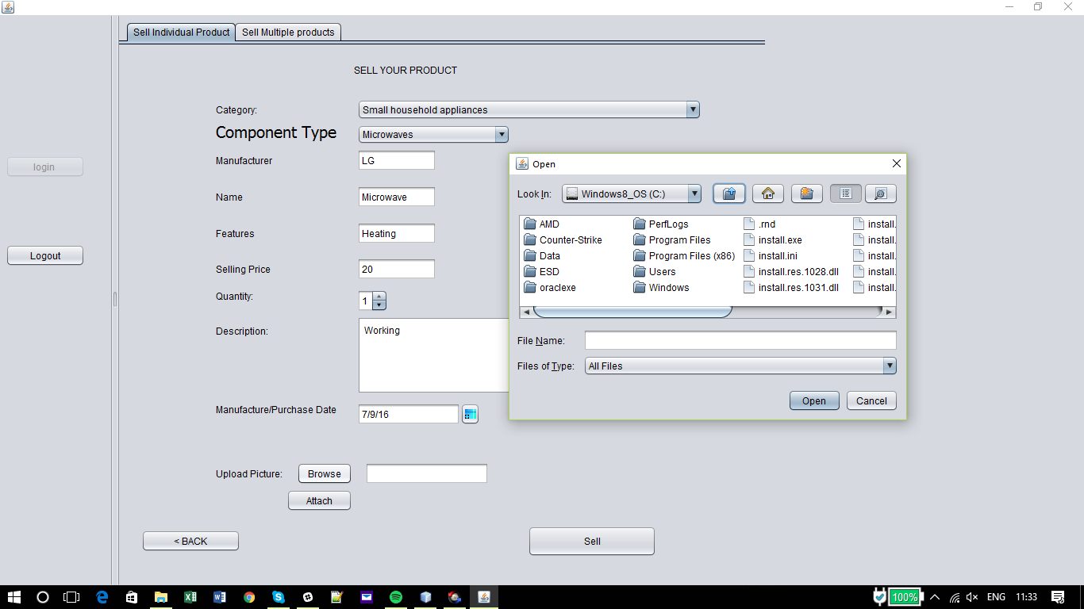
Screenshot

Slide 14
